Slide 1
Android Device Risk Assessment Tool
Using Common Permissions to Identify Applications Used in Intimate Partner Violence
Kathryn Reardon
December 1, 2020

Slide 2
Problems to Be Addressed
Intimate partner violence (IPV) is a public health concern involving physical violence, sexual violence, stalking, or psychological harm by a current or former partner or spouse.
1 in 4 women and 1 in 10 men in the United States will experience some form of IPV in their lifetime.
One form of abuse uses technology to stalk, harass, and control victims.
Surveillance spyware applications allow tech-unsavvy abusers to easily track a victim’s device.

Slide 3
Goals
Improve spyware-detection efficacy beyond blacklisting.
Obtain and analyze permissions of known spyware applications using guilt by association.
Inspect victim device without arousing attacker’s suspicion.
Accurately assess likelihood that application is or is not spyware.
Design tool to be user-friendly and easy to understand.

Slide 4
Threat Model
Who is the attacker?
The current or former partner or spouse of the victim.
May share a home or children with the victim.
What does the attacker know?
Typically not knowledgeable about technology.
The victim’s personal and private information, such as answers to security questions, passwords, and PINs.
What does the attacker have access to?
Has physical access to the victim’s device (may even be the owner of the device or account).
What can the attacker do?
Depends on the spyware application, but can include location tracking, controlling the camera, recording audio and video, forwarding text messages, reading deleted text messages, and preventing uninstallation.

Slide 5
BackgrounD
This project continues research started by NYC-based researchers at Cornell Tech, Cornell University, and NYU.
Nicola (Nicki) Dell, Thomas (Tom) Ristenpart, Damon McCoy, and Karen Levy are the faculty members who have worked with a host of PhD and MS students uncovering the threat of technology in IPV.
Their work has revealed the threat, discovered how victims are targeted, identified the applications used in attacks, designed a computer security clinic, created a tool to identify spyware on a victim’s device, and developed an algorithm to identify spyware applications based on co-installed known spyware applications.

Slide 6
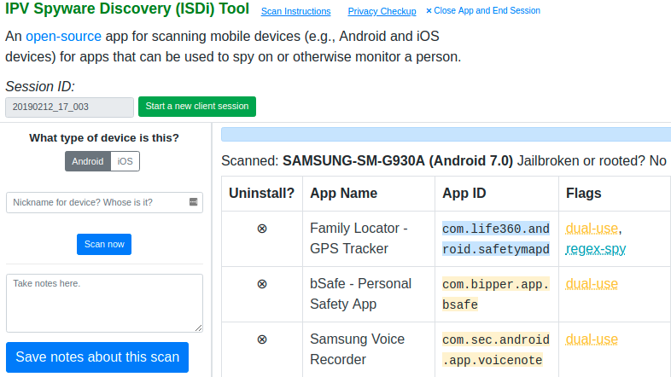
IPV Spyware Discovery Tool (ISDi)
ISDi is a Python application which displays information about a USB-connected device in a web browser. It relies primarily on blacklisting for detection.

Slide 7
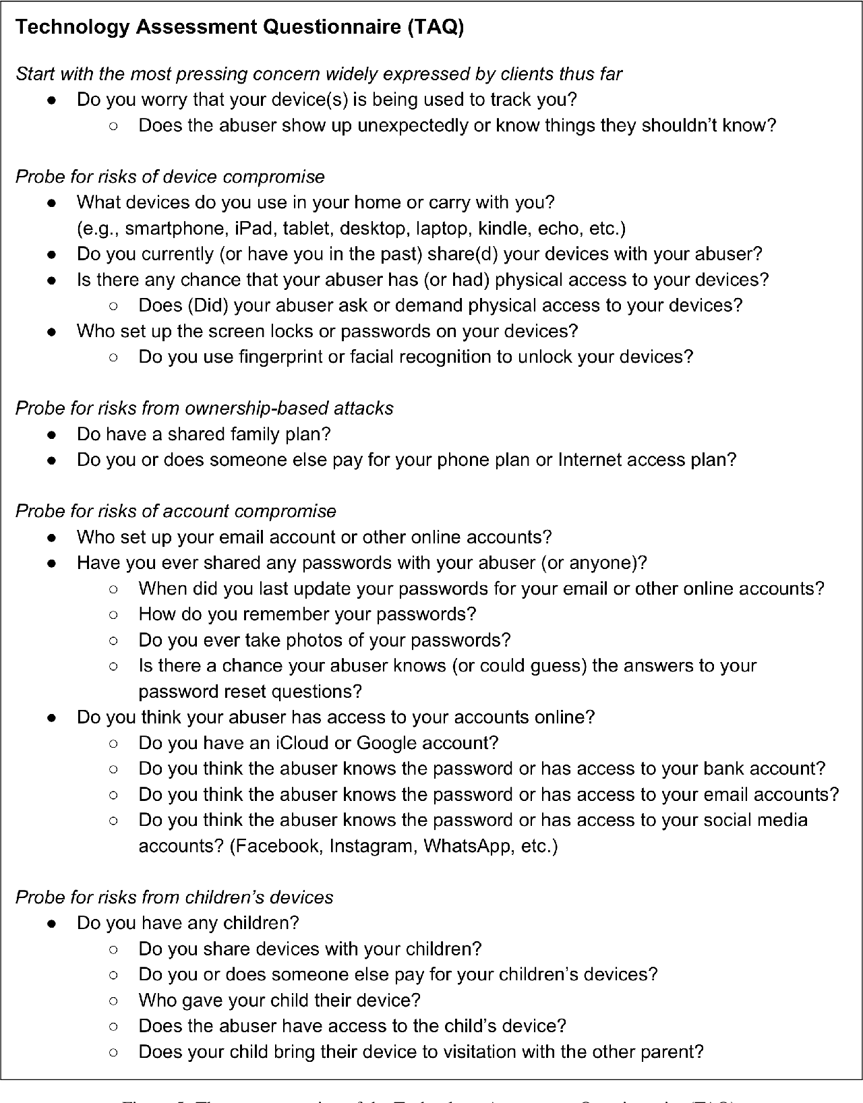
Technology Assessment Questionnaire (TAQ)
The TAQ serves as the first step in understanding the potential avenues for harm.

Slide 8
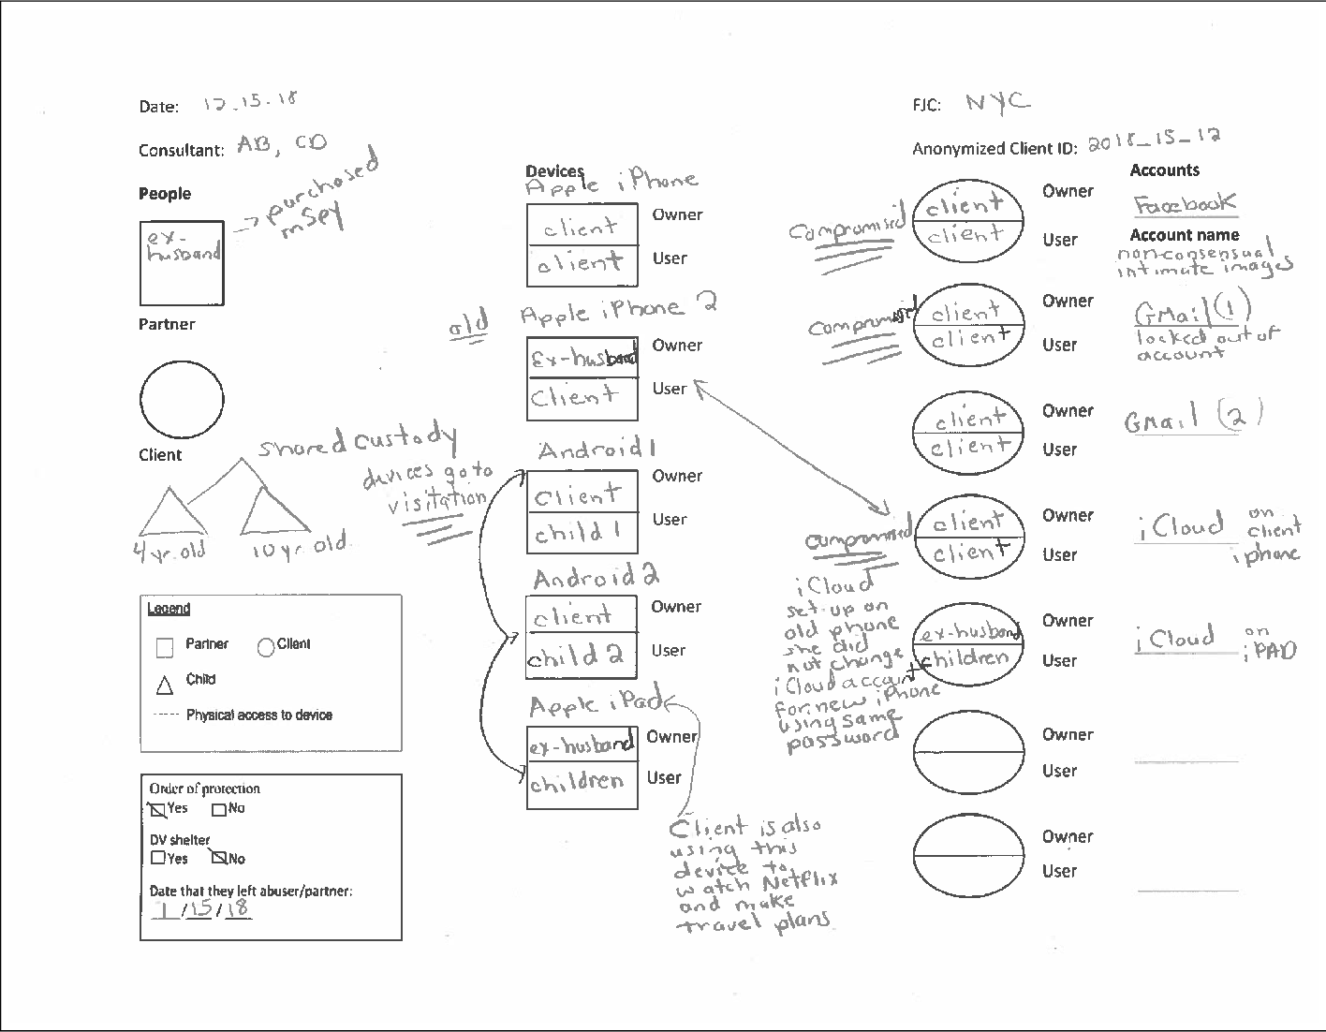
Technograph
The technograph helps the technician and client visualize the relationships between devices, accounts, and people.

Slide 9
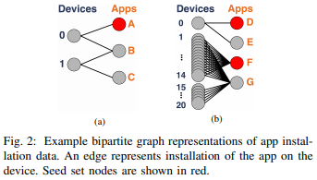
CreepRank Algorithm
The CreepRank algorithm uses graph mining to compute scores using maximum a posteriori estimation using the principle of guilt by association: “software that disproportionately appears on the same device as known malware is, itself, likely to be malicious.”

Slide 10
Dataset Description
20 known spyware applications found in other studies and through search engines:
AllTracker Anti-Theft iKeyMonitor
Android Monitors IP Webcam
Cell Tracker Kids iSpyoo
Cerberus Mrecorder
Clone WhatsWeb Pro Screen Recorder
Control by SMS SMS Forwarder
FamiSafe Spy GPS SMS Call Controller
Girlfriend Cell Tracker Spy To Mobile
Highster Mobile TrackView
Hoverwatch Unseen – No Last Seen
20 most downloaded or suggested non-spyware applications :
Amazon Pokemon GO
Among Us Seamless
Cash App Snapchat
Facebook Spotify
Gmail TikTok
Google Maps Twitter
Instagram Uber
Lyft Weather Channel
Facebook Messenger WhatsApp
Netflix YouTube

Slide 11
Types of Permissions
Install-time:
Automatically granted when the user installs the application.
Minimal data access or performed action risk.
“Normal” and “signature.”
Runtime:
Must be explicitly granted by the user when first opening the application.
Allow access to private user data or control over device and other applications.
“Dangerous.”
Created categories:
“Removed”: Deprecated in a previous level of the API.
“Other”: Not enough documentation to assess.
“Unknown”: Developer-specified.

Slide 12
Guilt by association
Category | Weight
Very Dangerous | 3 + frequency
Moderately Dangerous | 2 + frequency
Less Dangerous | 1 + frequency
Only Spyware Dangerous | 1.5 + frequency
Only Popular Dangerous | 1
Shared Signature | 1 + frequency
Only Spyware Signature | 3 + frequency
Only Popular Signature | 1
Removed | 0.3
The CreepRank algorithm assumes that applications co-installed on a device with known spyware are more likely to be spyware themselves.
This algorithm assumes that permissions used in an application that are also used in known spyware are more likely to be used for spyware purposes, implying the application is spyware.
Three patterns emerged from the data:
Use of dangerous permissions
Use of signature permissions
Use of removed permissions
The heuristic weights are affected by the perceived threat of the permissions and how frequently they are used.
Risk score modifier:
If the ratio of weighted permissions to total permissions is greater than 0.4, add 1 + ratio to the risk score.

Slide 13
VERY Dangerous Permissions
Name | Percent Used in Spyware | Percent Used in Popular
WRITE_EXTERNAL_STORAGE | 85% | 80%
ACCESS_FINE_LOCATION | 75% | 70%
READ_EXTERNAL_STORAGE | 75% | 70%
ACCESS_COARSE_LOCATION | 70% | 60%
READ_CONTACTS | 70% | 65%
READ_PHONE_STATE | 70% | 65%

Slide 14
Moderately Dangerous Permissions
Name | Percent Used in Spyware | Percent Used in Popular
RECORD_AUDIO | 55% | 50%
CAMERA | 50% | 70%
READ_SMS | 50% | 10%
RECEIVE_SMS | 50% | 15%
GET_ACCOUNTS | 45% | 70%
CALL_PHONE | 35% | 25%
ACCESS_BACKGROUND_LOCATION | 30% | 15%

Slide 15
Less Dangerous Permissions
Name | Percent Used in Spyware | Percent Used in Popular
ACCESS_MEDIA_LOCATION | 25% | 15%
READ_CALENDAR | 25% | 20%
SEND_SMS | 25% | 15%
RECEIVE_MMS | 10% | 5%
WRITE_CONTACTS | 5% | 20%

Slide 16
Only Spyware Dangerous Permissions
Name | Percent Used
READ_CALL_LOG | 50%
PROCESS_OUTGOING_CALLS | 45%
ACCESS_SUPERUSER | 15%
READ_PHONE_NUMBERS | 10%
WRITE_CALL_LOG | 10%
DEVICE_ADMIN_ENABLED | 5%

Slide 17
Only Popular Dangerous Permissions
Name | Percent Used
ACTIVITY_RECOGNITION | 15%
WRITE_CALENDAR | 10%

Slide 18
Shared Signature Permissions
Name | Percent Used in Spyware | Percent Used in Popular
SYSTEM_ALERT_WINDOW | 45% | 25%
WRITE_SETTINGS | 30% | 5%
REQUEST_INSTALL_PACKAGES | 10% | 10%

Slide 19
Only Spyware Signature Permissions
Name | Percent Used
PACKAGE_USAGE_STATS | 20%
READ_PRIVILEGED_PHONE_STATE | 15%
INTERACT_ACROSS_USERS | 10%
INTERACT_ACROSS_USERS_FULL | 10%
READ_LOGS | 10%
WRITE_SECURE_SETTINGS | 10%
BIND_DEVICE_ADMIN | 5%
BIND_ACCESSIBILITY_SERVICE | 5%
BIND_NOTIFICATION_LISTENER_SERVICE | 5%
CAPTURE_AUDIO_OUTPUT | 5%
CHANGE_CONFIGURATION | 5%
MANAGE_DEVICE_ADMINS | 5%
MANAGE_USERS | 5%
MODIFY_PHONE_STATE | 5%
OVERRIDE_WIFI_CONFIG | 5%
REBOOT | 5%
STATUS_BAR | 5%
TETHER_PRIVILEGED | 5%
UPDATE_APP_OPS_STATS | 5%
com.android.launcher.permission.WRITE_SETTINGS | 5%

Slide 20
Only Popular Signature Permissions
Name | Percent Used
BATTERY_STATS | 5%
MANAGE_DOCUMENTS | 5%

Slide 21
Removed Permissions
Name | Percent Used in Spyware | Percent Used in Popular
READ_PROFILE | 15% | 40%
USE_CREDENTIALS | 15% | 50%
FLASHLIGHT | 10% | 15%
WRITE_SMS | 10% | 5%
AUTHENTICATE_ACCOUNTS | 5% | 35%
MANAGE_ACCOUNTS | 5% | 45%
com.android.browser.permission.READ_HISTORY_BOOKMARKS | 25% | -
com.android.browser.permission.WRITE_HISTORY_BOOKMARKS | 10% | -
READ_HISTORY_BOOKMARKS | 5% | -
READ_USER_DICTIONARY | 5% | -
WRITE_USER_DICTIONARY | 5% | -
SUBSCRIBED_FEEDS_READ | - | 5%
SUBSCRIBED_FEEDS_WRITE | - | 5%

Slide 22
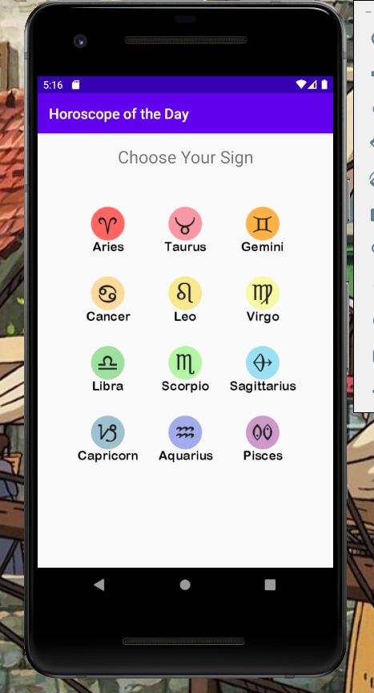
The Horoscope Application
The Horoscope application appears to be a simple daily horoscope, but it also gathers information about other applications on the installed device. This occurs as soon as the application is launched, so it may be uninstalled quickly after saving the data file.

Slide 23
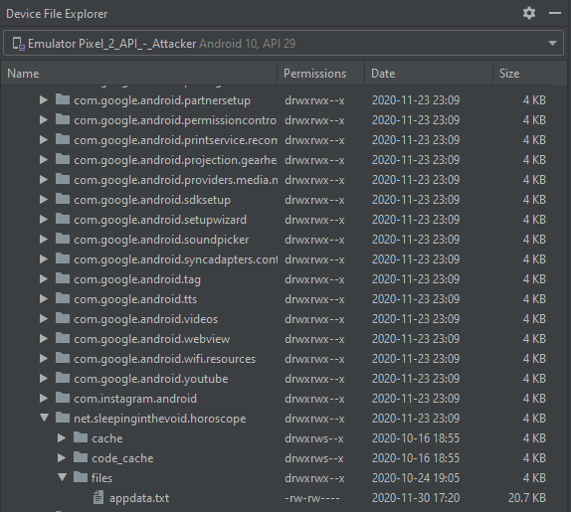
The Horoscope Application
Android Studio allows you to browse files on both emulated and physically connected devices, which is where the application information can be saved for use in the risk assessment tool.

Slide 24
risk assessment tool
AssessAppRisk uses the guilt by association weighted algorithm to assign a risk score to each installed application.
The program also includes a whitelist for very popular programs (some of which have large risk scores).
Applications are rated on a scale from very unlikely to very likely to be spyware.
Risk Score | Assessment
0 | Very Unlikely
0 – 20 | Unlikely
20 – 50 | Slightly Likely
50 – 70 | Likely
70 – 129.05 | Very Likely

Slide 25
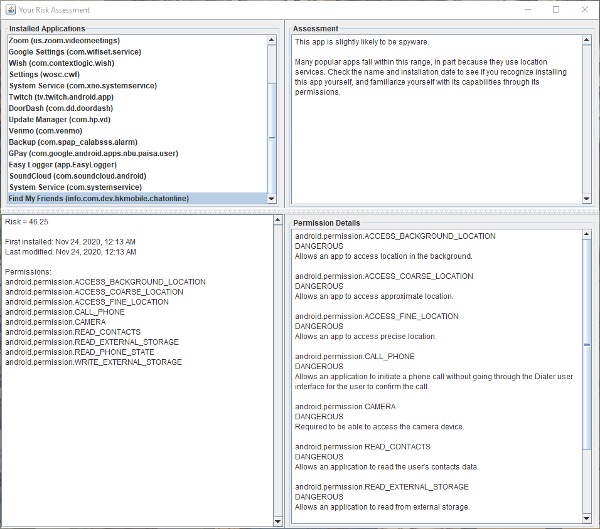
Risk Assessment Tool
AssessAppRisk’s assessment window has four panels: the top left shows the selection list of the installed applications, the bottom left shows the risk score and application details, the top right shows the assessment, and the bottom right shows details about the weighted permissions used by the application.

Slide 26
Evaluating Efficacy
Assessment | Spyware | Non-Spyware
Whitelisted | - | 80%
Very Unlikely | - | 5%
Unlikely | 20% | 5%
Slightly Likely | 30% | 10%
Likely | 25% | 0%
Very Likely | 25% | 0%
Assessment | Spyware | Non-Spyware
Whitelisted | - | -
Very Unlikely | - | -
Unlikely | - | 40%
Slightly Likely | 10% | 50%
Likely | 30% | 10%
Very Likely | 60% | -
Assessment | Spyware | Non-Spyware
Whitelisted | - | 6.7%
Very Unlikely | - | 4.5%
Unlikely | - | 33.7%
Slightly Likely | - | 47.2%
Likely | - | 7.9%
Very Likely | - | -
Original dataset (20 spyware, 20 non-spyware).
Test dataset (10 spyware, 10 non-spyware).
Real user dataset (no spyware, 89 non-spyware).
In the first two tests, AssessAppRisk correctly flagged over 75% of known spyware as some degree of likely to be spyware.
In each test, AssessAppRisk flagged less than 25% of non-spyware as likely or very likely to be spyware.
Much improvement could be made to lower the occurrences of non-spyware flagged as slightly likely.

Slide 27
Limitations
Difficulty finding sample spyware applications that were free to download and functional.
Inability to integrate work with ISDi.
Simplistic approach to guilt by association algorithm.

Slide 28
Implications
This project shows that permissions-based spyware detection is possible and may be efficient with more work.
It also proves the overreach of many popular applications, which ask for permissions that are not key to the application’s operation or which gather user data for the company’s own uses.

Slide 29
Future Work
Gather a larger sample of applications—especially spyware.
Better classification of permissions and explanation of use.
Convert simple risk assessment algorithm to one that is data-driven.
Integrate tool into existing spyware detection tools.

Slide 30
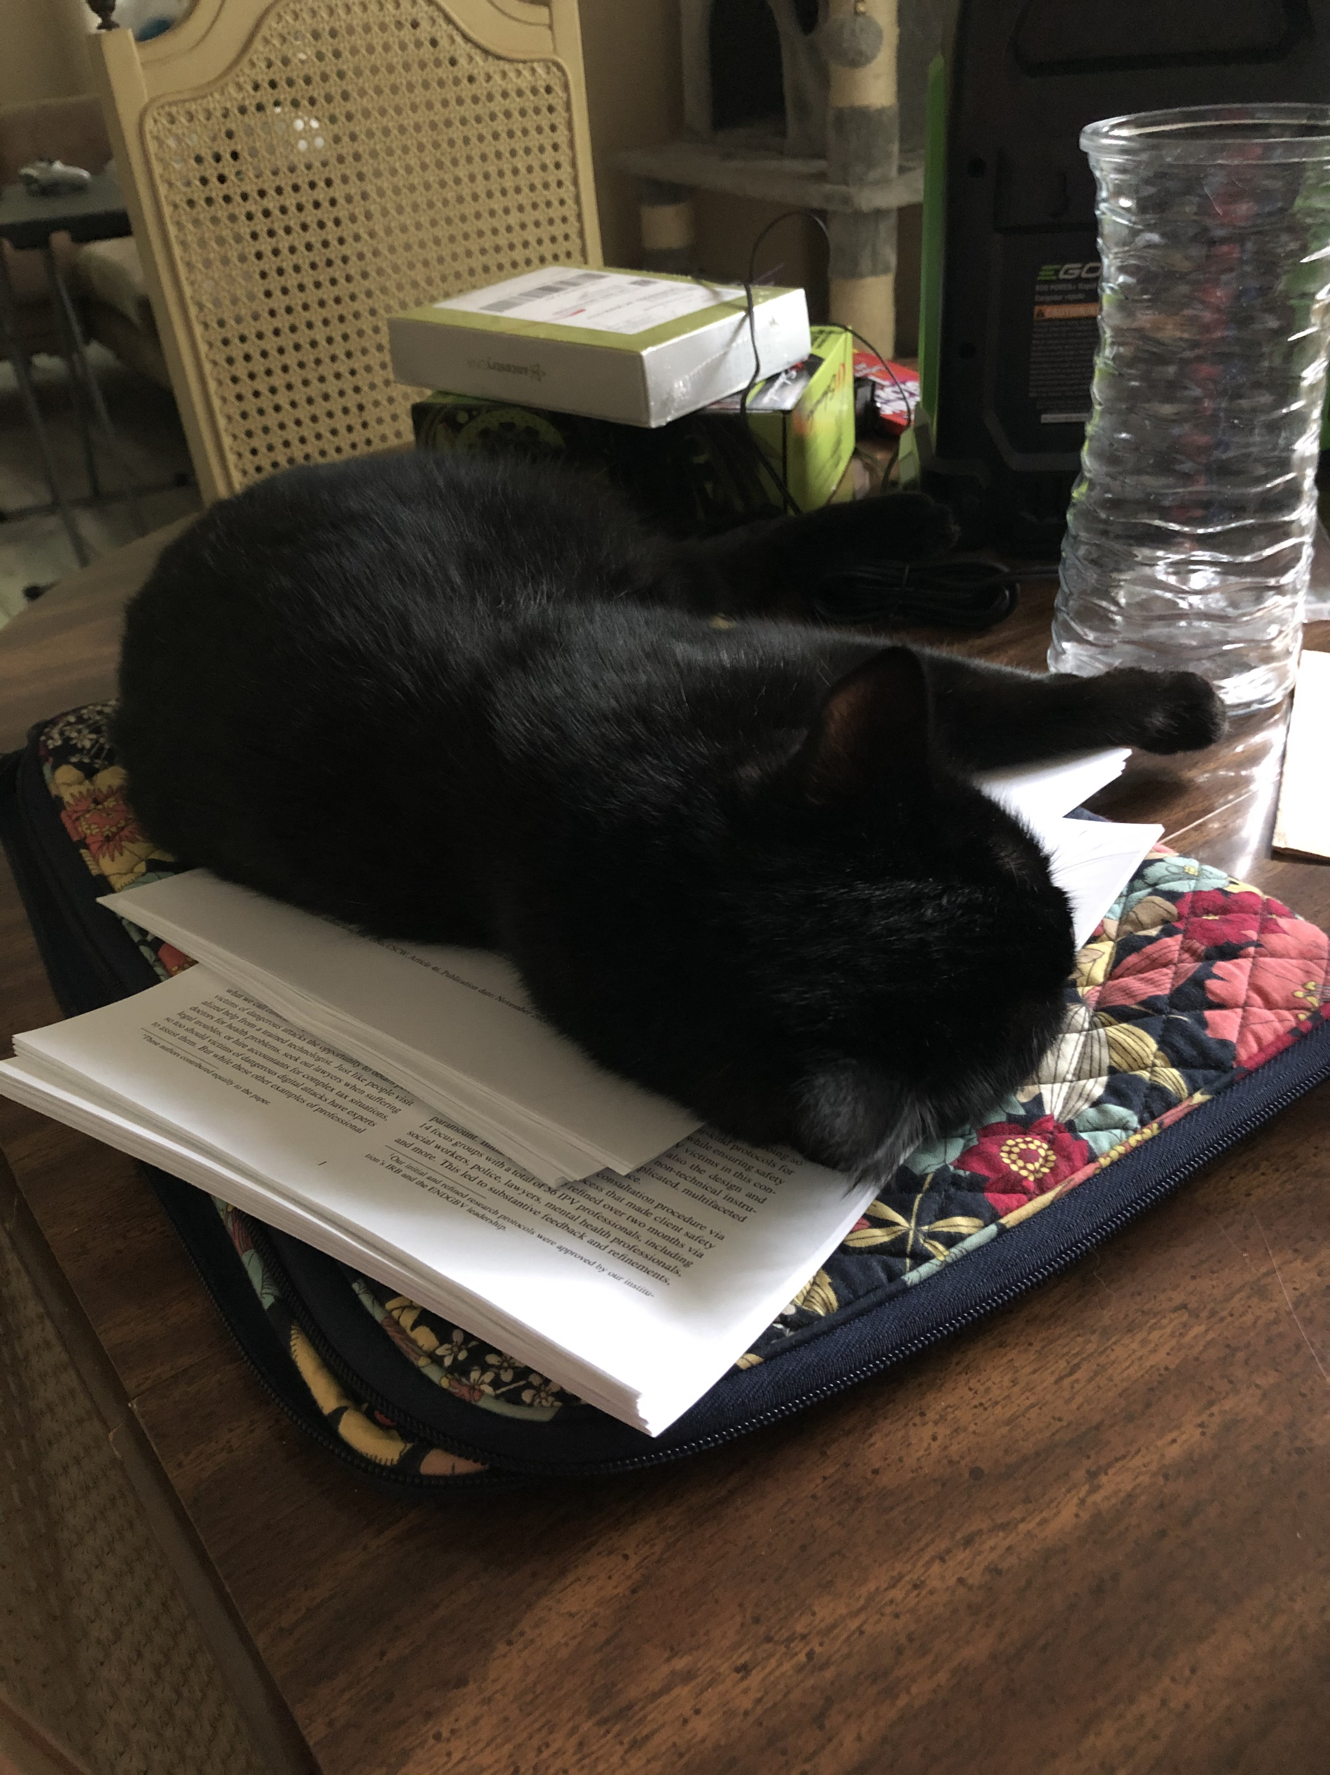
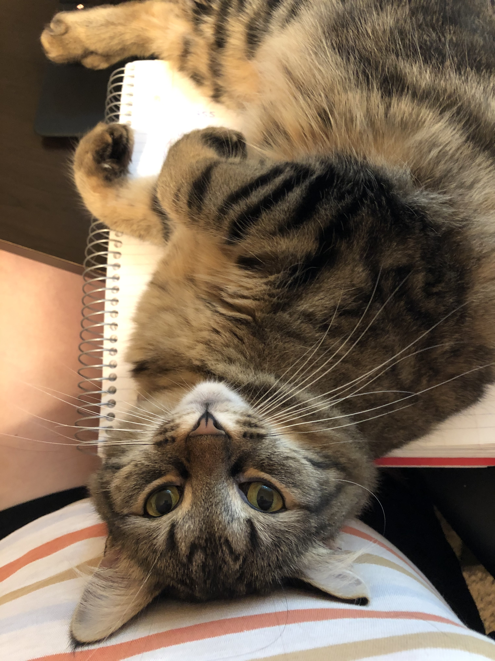
Questions
Special thanks to my research assistants.

